Slide 1
Kubernetes Setup and Configuration

Slide 2

Host Requirements
Host OS
Hardware Requirements
Ubuntu 16.04+
Debian 9
CentOS 7
RHEL 7
Fedora 25/26 (best-effort QoS)
2 GB or more of RAM per machine
2 CPUs or more
Network connectivity between all machines in the cluster
Unique hostname, MAC address, and product_uuid for every node

Slide 3
Kubernetes Cluster Support
No more than 5000 nodes
No more than 150000 total pods
No more than 300000 total containers
No more than 100 pods per node
Notes:
Minikube (single node kubernetes cluster)
Kubeadm (multi node kubernetes cluster)

Slide 4
Running Kubernetes on
Local-machine Solutions
Minikube
Hosted and Cloud Solutions
GCP, AWS, OpenShift Dedicated, OpenShift Online, Kubermatic
On Premise
Notes:
Minikube (single node kubernetes cluster)
Kubeadm (multi node kubernetes cluster)

Slide 5
Installing Kubernetes on Premise
Creating a custom cluster from scratch
https://kubernetes.io/docs/getting-started-guides/scratch/
Bootstrapping clusters with installation tools
Kubeadm
Kubespray
kops
Notes:
Minikube (single node kubernetes cluster)
Kubeadm (multi node kubernetes cluster)

Slide 6
Kubernetes Installation Tools/ Resources
kubeadm
kubeadm is a first-class citizen on the Kubernetes ecosystem
Secure and recommended way to bootstrap the Kubernetes cluster
kubespray
With Kubespray, we can install highly available Kubernetes clusters on AWS, GCE, Azure, OpenStack, or Bare Metal
Kubespray is based on Ansible, and is available on most Linux distributions
kops
With Kops, we can create, destroy, upgrade, and maintain production-grade, highly-available Kubernetes clusters from the command line.
It can provision the machines as well. Currently, AWS is officially supported
Support for GCE and VMware vSphere are in alpha stage, and other platforms are planned for the future

Slide 7
Kubernetes Installation Considerations
High Availability
Upgrades
Support for hybrid
Federation support
Enterprise-ready features
Notes:
High Availability – Does your Kubernetes solution install clusters that are highly available, with replication of the underlying metadata for recovery against failures?
Upgrades – Kubernetes community delivers a major upgrade every 3-4 months. What is your Kubernetes upgrade strategy? What downtimes will upgrades require and is that acceptable for business?
Support for hybrid – Does your Kubernetes solution equally support the private data center and public cloud endpoints that your business needs to deliver Kubernetes on? Does it offer same or similar level of SLA and functionality across them?
Federation support – Does your Kubernetes solution support installation of federated clusters that can grow across private and public clouds for robustness of infrastructure and dynamic burstability?
Enterprise-ready features – What additional enterprise-readiness features does your Ops team need to run Kubernetes at scale and support large scale of users? Are they supported by your Kubernetes solution of choice? Some examples include, SSO support, RBAC, isolated networking, persistent storage.

Slide 8
Kubernetes Installation Options
All-in-One Single-Node Installation
All the Master and Worker components are installed on a single node.
Very useful for learning, development, and testing. Minikube is one such example
Single-Node etcd, Single-Master, and Multi-Worker Installation
We will have a single Master Node, which will also run a single-node etcd instance. Multiple Worker Nodes are connected to the Master Node.
Multi-Node etcd, Multi-Master, and Multi-Worker Installation
In this mode, etcd is configured in a clustered mode, outside the Kubernetes cluster, and the Nodes connect to it. The Master Nodes are all configured in an HA mode, connecting to multiple Worker Nodes.

Slide 9
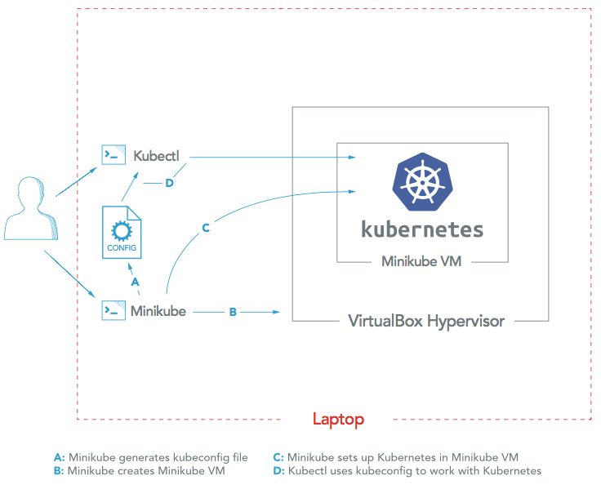
All-in-one

Slide 10
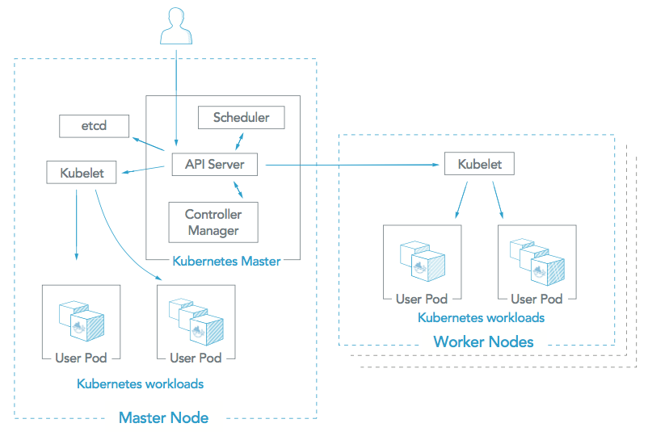
Single etcd/ Master and Multi-Worker

Slide 11
Kubeadm Overview
Kubeadm is a toolkit for bootstrapping a best-practices Kubernetes cluster on existing infrastructure.
Kubeadm cannot provision your machines i.e. they need to be pre-provisioned

Slide 12
Creating a Cluster with Kubeadm
Provision several Linux machines with a Linux flavor
Install kubeadm
Make one of your machines the master (or the control plane)
Install a pod networking layer like flannel, weave etc.
Join the other nodes to the master

Slide 13
Environment Setup
Cloud provider or hardware configuration
Setup hostname and IP address
Add host entries to /etc/hosts file
Update the server with the latest packages
Disable firewalld and SELinux service
Configure NTP service
Install base packages

Slide 14
Configure Kubernetes Repository
Kubernetes packages are not available in the default CentOS 7 & RHEL 7 repositories
cat <<EOF > /etc/yum.repos.d/kubernetes.repo
[kubernetes]
name=Kubernetes
baseurl=https://packages.cloud.google.com/yum/repos/kubernetes-el7-x86_64
enabled=1
gpgcheck=1
repo_gpgcheck=1
gpgkey=https://packages.cloud.google.com/yum/doc/yum-key.gpg https://packages.cloud.google.com/yum/doc/rpm-package-key.gpg
EOF

Slide 15
Install Kubernetes Packages
Kubeadm package is a Command-line utility for administering a Kubernetes cluster.
Once the package repositories are configured, run the beneath command to install kubeadm packages.
yum install kubeadm -y

Slide 16
Accessing Kubernetes Cluster using CLI
kubectl is the CLI tool to manage the Kubernetes cluster resources and applications.
Install binary on Linux, Windows or MAC OS and point to the master in a file - default is ~/.kube/config (Linux)
apiVersion: v1
clusters:
- cluster:
certificate-authority: /Users/joe/.minikube/ca.crt
server: https://192.168.99.100:8443

Slide 17
Start the Services and Initialize the Kubernetes
Enable and Start the docker and kubernetes services
systemctl enable docker kubelet
systemctl start docker kubelet
systemctl status docker
Initialize Kubernetes host with ‘kubeadm init’
Run the beneath command to initialize and setup kubernetes host.
kubeadm init
systemctl status kubelet

Slide 18
Verify the Kubernetes Pods and Nodes
Verify the kubernetes nodes status
kubectl get nodes
Verify the kubernetes pods status
kubectl get pods

Slide 19
Join Node to Kubernetes Cluster
kubeadm join --discovery-token abcdef.1234567890abcdef --discovery-token-ca-cert-hash sha256:1234..cdef 1.2.3.4:6443
Verify Nodes status from master node using kubectl command
kubectl get nodes

Slide 20
Kubeadm Tools
kubeadm - tool built to provide kubeadm init and kubeadm join as best-practice “fast paths” for creating Kubernetes clusters
kubeadm init to bootstrap a Kubernetes master node
kubeadm join to bootstrap a Kubernetes worker node and join it to the cluster
kubeadm upgrade to upgrade a Kubernetes cluster to a newer version
kubeadm config if you initialized your cluster using kubeadm v1.7.x or lower, to configure your cluster for kubeadm upgrade
kubeadm token to manage tokens for kubeadm join
kubeadm reset to revert any changes made to this host by kubeadm init or kubeadm join

Slide 21
Deploying Nginx Server
Create the nginx pod using kubectl
kubectl create -f nginx_pod.yaml
Verify the kubernetes pods status
kubectl get pods
Verify the kubernetes replicas status
kubectl get rc

Slide 22
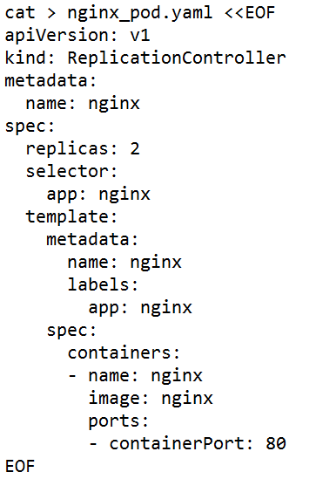
POD Definition

